Slide 1
Thinking of and with data: How students and teachers (and researchers) use data in STEM education
Joshua M. Rosenberg, Doctoral Candidate
Michigan State University
January 24th, 2018
University of Tennessee, Knoxville
Department of Theory and Practice of Teacher Education
Notes:
Work with data
Also implications
Mention NGSS
Make a slide
Thank you to the Mehmet Aydeniz and the search committee and the faculty and students in the TPTE department as well as Ms. Gina Guinn for making this trip possible.
This talk is on thinking of and with data in STEM.
In particular, this talk is focused on the affordances of new sources of data for teachers and students.
And, is on how new sources of data can help us understand teaching and learning in STEM.
Work with data can help students (and teachers) across STEM classrooms to go beyond “doing school” to engage in disciplinary practices, such as analyzing and interpreting data and developing and using models. Using authentic sources of data in classroom contexts can be challenging because of the time and planning such work takes as well as how it differs from how students have traditionally worked with data at school. In this talk, I describe research on how students engage with authentic sources of data in science classrooms and summer STEM enrichment programs. Also, I show how researchers can use a variety of data sources and methods to understand student engagement with data and other science and STEM activities. I discuss implications for teachers, teacher educators and professional development providers, and for the design of educational technologies. Finally, I outline some future directions for uses of data across STEM disciplines.

Slide 2
About Me
Introduction | Text | ESM | Digital Traces | Future Work | Conclusion
How you came to be interested in science, and data in particular.
Notes:
why you went to grad school

Slide 3
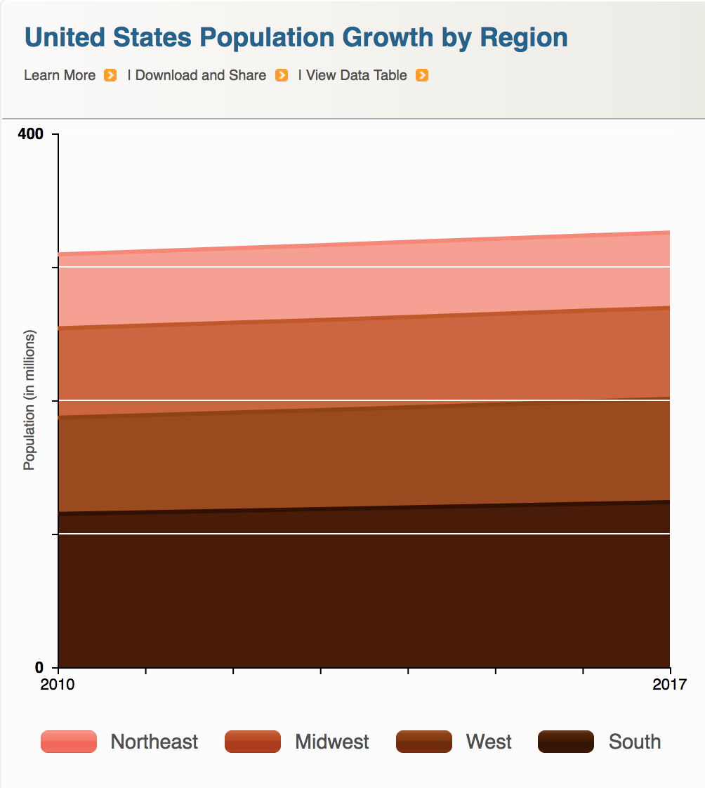
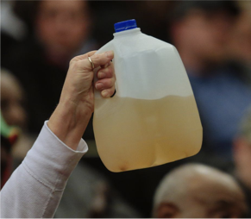

Data is power(ful)
Introduction | Text | ESM | Digital Traces | Future Work | Conclusion
Companies
Government
Citizens

Slide 4
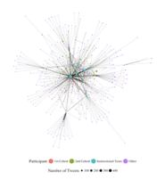
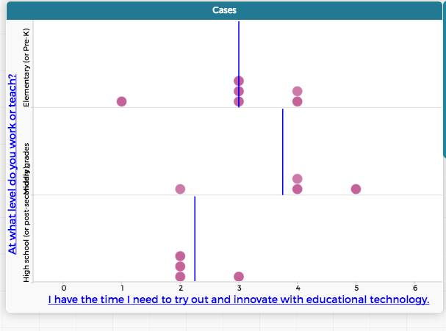
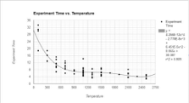
Data is power(ful)
Introduction | Text | ESM | Digital Traces | Future Work | Conclusion
Researchers
Teachers
Students
Notes:
talking about agency

Slide 5
My Research Interest
At the broadest level, my research examines the role and use of data in K-12 STEM research, teaching, and learning
Taught H.S. Biology, Chemistry, and Earth Science
Motivated by challenges and opportunities from helping students to do science, particularly with technological tools
Apply research to teaching about technology integration in science education, especially on teachers’ Technological Pedagogical Content Knowledge (TPACK)

Slide 6
More Specifically
I ask a wide range of questions
How students engage in collecting data?
How students interpret data?
What new forms of data can researchers use to understand education?
What new forms of digital data that we make on twitter, facebook, and course management systems can tell us about teaching and learning
How do we make sense of the data that comes from simulations?
How can teachers support students work with data?

Slide 7
More Specifically
I ask a wide range of questions
How do K-12 students who work with data in science education engage in their learning?
Notes:
As you can see, I have a lot of questions and interests about the use of data in science education research, teaching, and learning. I obviously can’t talk about all of these questions today, but I will,
Touch on some of them briefly,
And later, I’ll go into some considerable depth on one of them.

Slide 8

Example: Teachers use of Twitter
SETH
(connect to one of the questions in the list)
Where the “data” is
What you learned about the question above

Slide 9
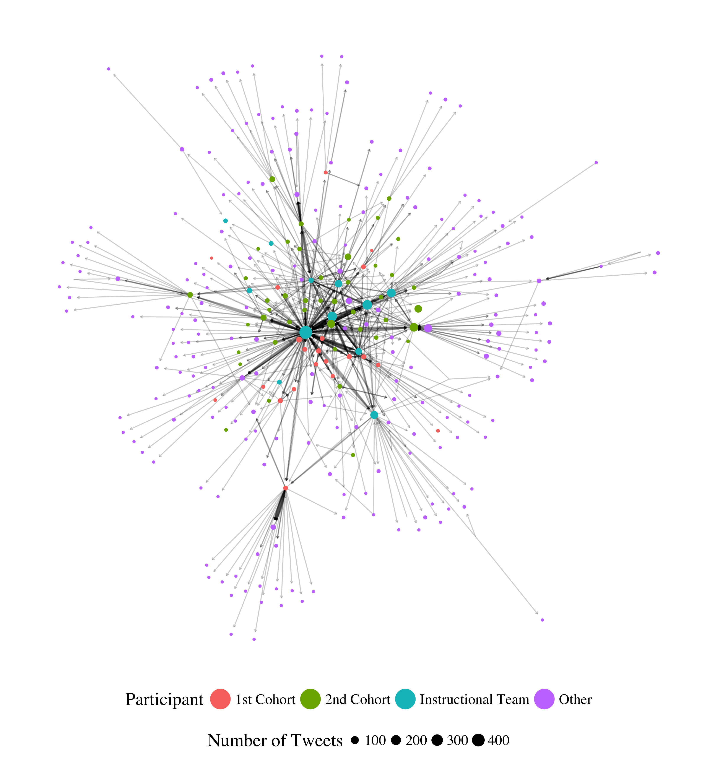
Example: Communities on Twitter
Hashtag
(connect to one of the questions in the list)
Where the “data” is
What you learned about the question above

Slide 10
Example: Portfolios
Portfolios
(connect to one of the questions in the list)
Where the “data” is
What you learned about the question above

Slide 11
Example: Teachers’ Text
LWIC
(connect to one of the questions in the list)
Where the “data” is
What you learned about the question above

Slide 12
Example: MVU Simulations
Simulations
(connect to one of the questions in the list)
Where the “data” is
What you learned about the question above

Slide 13
Example: Flipped Classrooms
Simulations
(connect to one of the questions in the list)
Digital Logs
What you learned about the question above

Slide 14
How do K-12 students who work with data in science education engage in their learning?
Notes:
For the rest of this talk, I want to zoom in one particular set of questions.

Slide 15

Work with data
Introduction | Text | ESM | Digital Traces | Future Work | Conclusion

Slide 16
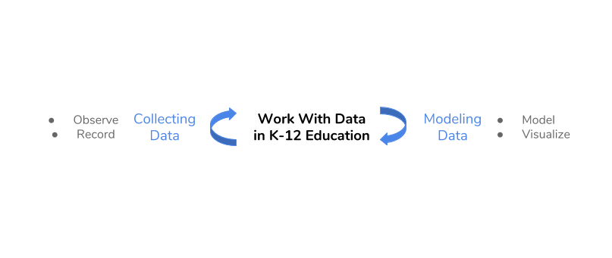
Work with data
Introduction | Text | ESM | Digital Traces | Future Work | Conclusion

Slide 17
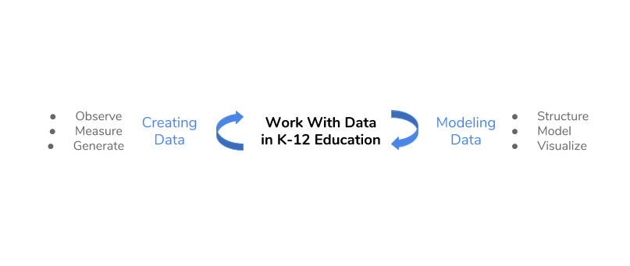
Work with data
Introduction | Text | ESM | Digital Traces | Future Work | Conclusion

Slide 18
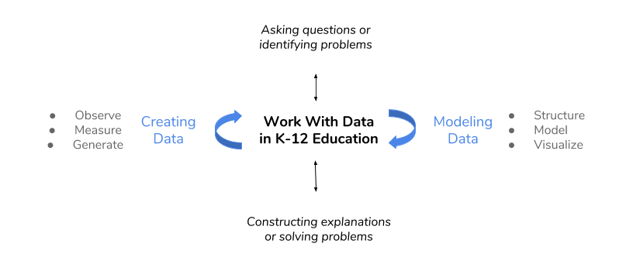
Work with data
Introduction | Text | ESM | Digital Traces | Future Work | Conclusion
Hancock, Kaput, & Goldsmith, 1992; Wild & Pfannkuch, 1999
NGSS Lead States, 2013; National Research Council, 2012

Slide 19
Work with data
Introduction | Text | ESM | Digital Traces | Future Work | Conclusion
Researchers’ design and development
Use of new data sources and methods for research
Hancock, Kaput, & Goldsmith, 1992; Wild & Pfannkuck, 1999
NGSS Lead States, 2013; National Research Council, 2012
Notes:
Requires sustained focus on one topic / phenomena
Shift from work with data in schools focusing on small, organized data sets
Requires using skills from across disciplines
Helps teachers and students to go beyond “doing school”
Provide opportunities for positive feedback loops
Can empower students to engage in inquiry in their lives Can prepare students for data-intensive occupations

Slide 20
Background
Introduction | Text | ESM | Digital Traces | Future Work | Conclusion
For students to work with data, they need support from teachers, tools, and curricula
For teachers to support work with data, they need time and professional development and support
For researchers to study work with data, they need to design contexts for work with data and to use new data sources and methods to study engagement and learning

Slide 21
Two Studies
Introduction | Text | ESM | Digital Traces | Future Work | Conclusion
Two studies to explore these set of issues

Slide 22
STUDY ONE
Introduction | Text | ESM | Digital Traces | Future Work | Conclusion
Explored “business-as-usual” and hands-on science, activities using a person-in-context approach (Schmidt, Rosenberg, & Beymer, 2018, JRST)
Tell about the classroom, students, what was “science” in these classrooms (i.e., what was “business as usual”)
Notes:
Demonstrate how data can be used to empower teachers and students.
What role this play

Slide 23
Context and Sample
Introduction | Text | ESM | Digital Traces | Future Work | Conclusion
12 high school classrooms
Large high school outside of a large metropolitan area
244 students
Notes:
Measures:
Experience Sampling Method for engagement and choice
Activities coded from video-recordings
Person-in-context approach:
Two step cluster analysis (Rosenberg, Schmidt, & Beymer, 2017)
Interpreted profile solutions on the basis of measures of fit, cross-validation, and concerns of parsimony

Slide 24
Research Question
Introduction | Text | ESM | Digital Traces | Future Work | Conclusion
To understand how learning activities (e.g., laboratory activities or lecture) and being able to choose impact students’ engagement
Notes:
Demonstrate how data can be used to empower teachers and students.
What role this play

Slide 25
Experience sampling method (ESM)
Introduction | Text | ESM | Digital Traces | Future Work | Conclusion
Involves asking people about their experiences using short surveys
Use of an app on phone
Every 15-30 minutes
“When you were signaled, how interested were you in what you were learning?”
Notes:
To look at this question, we also had to think hard about data, and new sources of data. We used a relatively new type of data called ESM.

Slide 26
Why ESM?
Introduction | Text | ESM | Digital Traces | Future Work | Conclusion
Understand learning experiences in a qualitatively distinct way (Hektner, Schmidt, & Csikszentmihalyi, 2007)
Helps us to understand moment-to-moment changes in experiences and what impacts experiences
Allows us to understand experiences during activities rather than overall pre- and post-assessments of what did or did not work
Notes:
I know this past research is a stretch – I would like to keep this just for the moment :)
Importance (but under-emphasis on) context in research on teacher knowledge (Rosenberg & Koehler, 2015)
Role of context in explaining processes around teaching and learning with technology (Phillips, Koehler, & Rosenberg, 2016)

Slide 27
Constructing Profiles
Introduction | Text | ESM | Digital Traces | Future Work | Conclusion
Cognitive, Behavioral, and Affective Engagement
Explain how you get profiles
Why?
Notes:
I know this past research is a stretch – I would like to keep this just for the moment :)
Importance (but under-emphasis on) context in research on teacher knowledge (Rosenberg & Koehler, 2015)
Role of context in explaining processes around teaching and learning with technology (Phillips, Koehler, & Rosenberg, 2016)

Slide 28
Coding of Data Practices
Introduction | Text | ESM | Digital Traces | Future Work | Conclusion
Work With Data | Description
Asking questions or defining problems | Discussing and exploring topics to investigate and pose questions.
Making observations | Watching and noticing what is happening with respect to the phenomena or problem being investigated.
Generating data | Figuring out how or why to record an observation as data and generating coding frames or measurement tools.
Data modeling | Understanding and explaining phenomena using models of the data that account for variability or uncertainty.
Interpreting and communicating findings | Discussing and sharing and presenting findings.
Notes:
Instead of categorizing things by laboratory, individual work, etc., we categorized by these six categories which represent different data practices

Slide 29
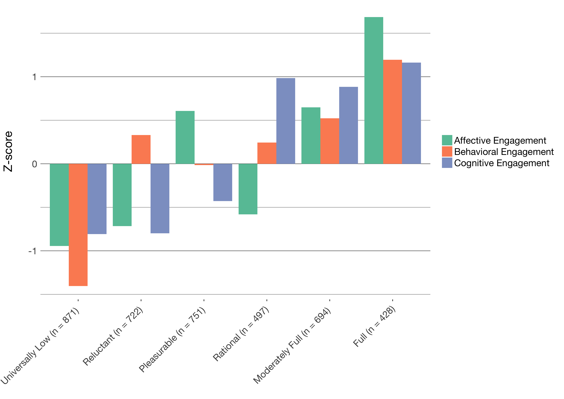
Profiles of engagement
Introduction | Text | ESM | Digital Traces | Future Work | Conclusion
Identified momentary profiles of engagement
Found six profiles from Universally Low to Full, with four complex patterns
Note that students report multiple profiles

Slide 30
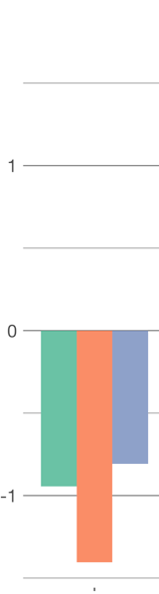
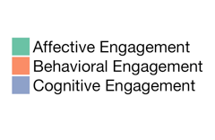
Universally Low
Introduction | Text | ESM | Digital Traces | Future Work | Conclusion
What this means

Slide 31
Reluctant
Introduction | Text | ESM | Digital Traces | Future Work | Conclusion
What this means

Slide 32
Etc
Introduction | Text | ESM | Digital Traces | Future Work | Conclusion
What this means

Slide 33
Profiles of engagement
Introduction | Text | ESM | Digital Traces | Future Work | Conclusion
Identified momentary profiles of engagement
Found six profiles from Universally Low to Full, with four complex patterns
Note that students report multiple profiles

Slide 34
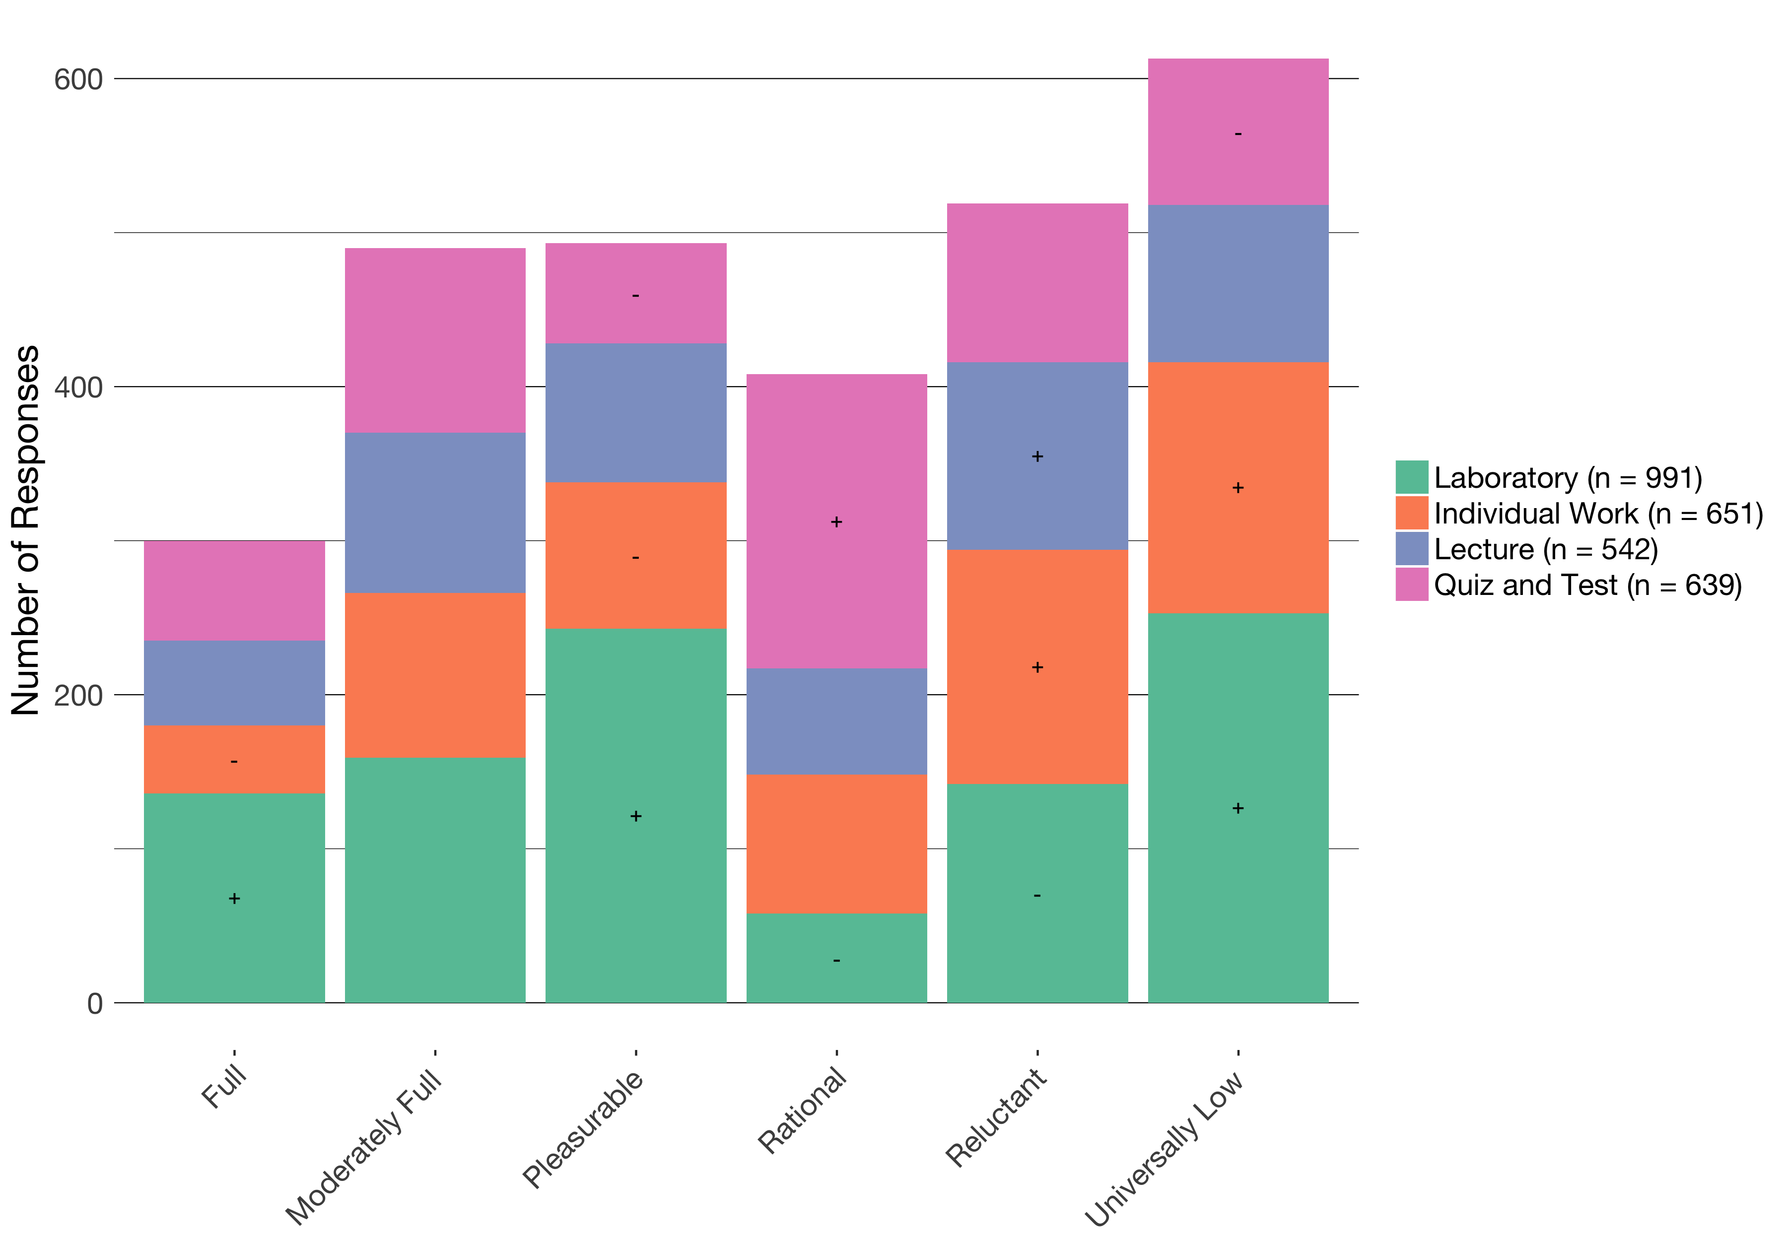
Profiles by activity
Introduction | Text | ESM | Digital Traces | Future Work | Conclusion
Notes:
Say more. About individual work.

Slide 35
The impacts of activity on engagement
Introduction | Text | ESM | Digital Traces | Future Work | Conclusion
Different activities in science are associated with different profiles of engagement
Laboratory activities can be particularly engaging (and disengaging)
Quizzes and tests have some affordances in terms of students’ engagement
Individual work can be particularly disengaging

Slide 36
Profiles by choice
Introduction | Text | ESM | Digital Traces | Future Work | Conclusion
Notes:
REMAKE THIS GRAPH BY CHOICE.

Slide 37
The impacts of choice on engagement
Introduction | Text | ESM | Digital Traces | Future Work | Conclusion
Choosing with whom to work is not associated with higher engagement
Choosing how much time to take is associated with rational engagement
Choosing how to do an activity or what the purpose or topic of the activity is associated with engaging profiles

Slide 38
Summary
Introduction | Text | ESM | Digital Traces | Future Work | Conclusion
Using the right kind of data, ESM, allowed us to study the impacts of the learning activity and choice when students work with data
Different activities in science are associated with different profiles of engagement
Providing chances for students to decide what to do or how to do it also impacts their engagement
As students move from activity to activity, their engagement can change
Notes:
Laboratory activities in science can be highly engaging
Choice—especially related to how students do laboratory activities and who determines how the activities is framed (choosing the purpose or topic)—is a key factor affecting how engaging laboratory activities are
Person-in-context approach helped us to characterize distinct profiles of engagement

Slide 39
STUDY 2
Introduction | Text | ESM | Digital Traces | Future Work | Conclusion
Notes:
Demonstrate how data can be used to empower teachers and students.
What role this play

Slide 40
Context and Sample
Introduction | Text | ESM | Digital Traces | Future Work | Conclusion
12 high school classrooms
Large high school outside of a large metropolitan area
244 students
Notes:
Context and Participants:
Nine summer STEM programs in urban areas in the Northeast
Highly diverse (90% of youth from historically under-represented [in STEM] groups)
204 youth, 2970 ESM responses

Slide 41
Research Question
Introduction | Text | ESM | Digital Traces | Future Work | Conclusion
To understand how data practices (e.g., collecting, analyzing, interpreting, etc.) impact students’ engagement
Notes:
Demonstrate how data can be used to empower teachers and students.
What role this play

Slide 42
Experience sampling method (ESM)
Introduction | Text | ESM | Digital Traces | Future Work | Conclusion
Notes:
Like the previous study, the data we used to answer this question was ESM.

Slide 43
Constructing Profiles
Introduction | Text | ESM | Digital Traces | Future Work | Conclusion
Cognitive, Behavioral, Affective, Challenge, and Competence
Explain how you get profiles
Why?
Notes:
Measures:
ESM self-reports for cognitive, behavioral, and affective and perceptions of challenge and competence
Video-recordings of activities
Pre-program measures of interest

Slide 44
Coding of Data Practices
Introduction | Text | ESM | Digital Traces | Future Work | Conclusion
Work With Data | Description
Asking questions or defining problems | Discussing and exploring topics to investigate and pose questions.
Making observations | Watching and noticing what is happening with respect to the phenomena or problem being investigated.
Generating data | Figuring out how or why to record an observation as data and generating coding frames or measurement tools.
Data modeling | Understanding and explaining phenomena using models of the data that account for variability or uncertainty.
Interpreting and communicating findings | Discussing and sharing and presenting findings.
Notes:
Instead of categorizing things by laboratory, individual work, etc., we categorized by these six categories which represent different data practices

Slide 45
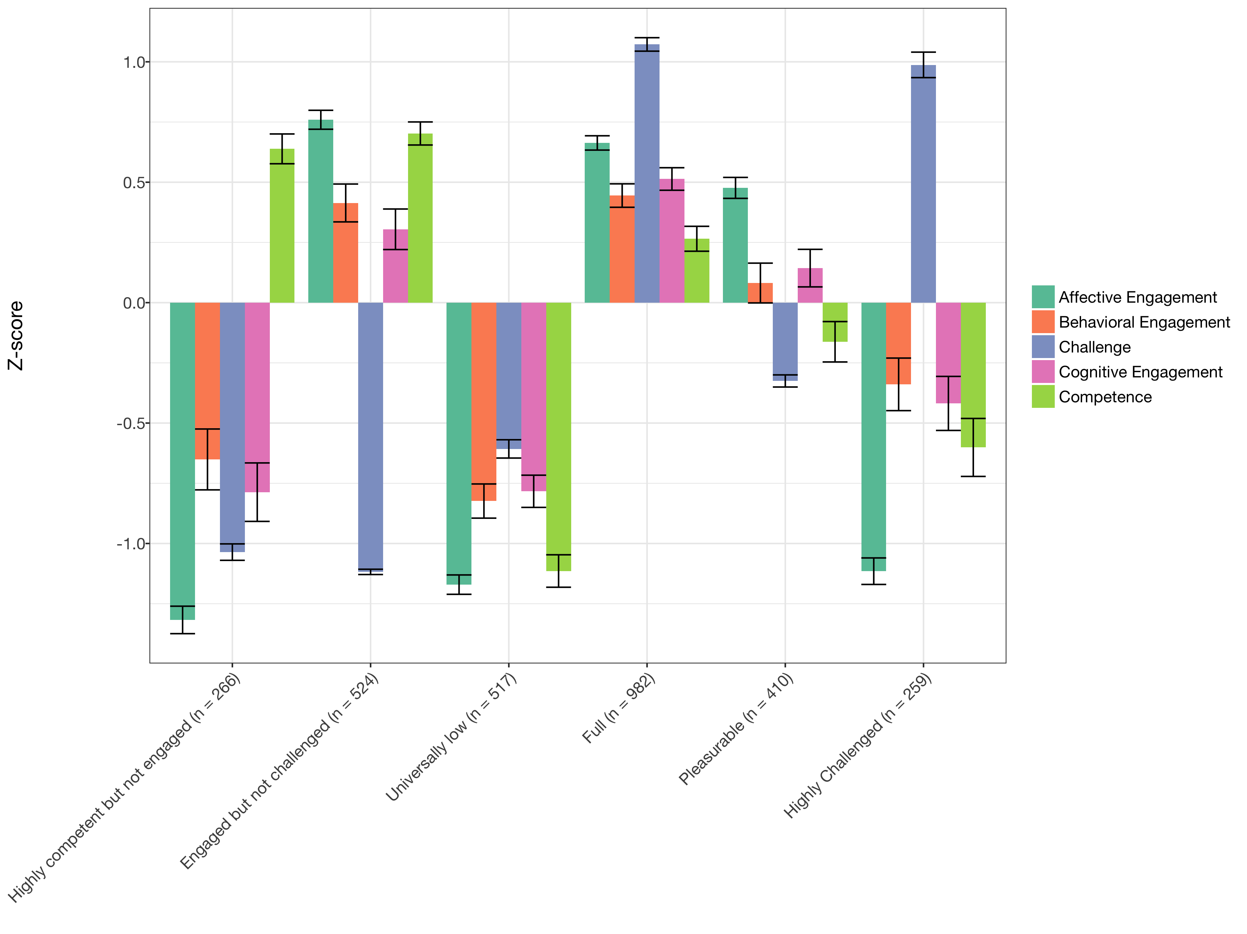
Profiles of engagement and its conditions
Introduction | Text | ESM | Digital Traces | Future Work | Conclusion
Developed tool for Latent Profile Analysis
Interpreted profiles using multiple criteria
Notes:
Do whatever you did in Study one to present these profiles. (Breaking into 6 slides, and 7th that puts them back together)

Slide 46
What the profiles tell us
Introduction | Text | ESM | Digital Traces | Future Work | Conclusion
When learners are challenged, they also need to think themselves as good at what they are doing to be highly engaged
When learners report Pleasurable engagement, their behavioral and cognitive engagement and perceptions of being challenged or good at the activity are moderate
When students report being Engaged but not Challenged, they may not be engaged in learning-related processes
Notes:
Mention more general findings

Slide 47
Engagement by Data Practice
Introduction | Text | ESM | Digital Traces | Future Work | Conclusion
Notes:
REMAKE THIS GRAPH BY DATA PRACTICE

Slide 48
Findings
Introduction | Text | ESM | Digital Traces | Future Work | Conclusion
When students report being Fully engaged:
Students are more likely to be generating data (B = 1.395, p = .029) and less likely to be observing phenomena (B = 0.410, p = .028)
Qualitative analysis of video suggests that modeling data is more often done by teachers (not students)
Notes:
6 profiles, model 2, estimated in Mplus via tidyLPA
Change the order of the clustered variables
Need to name the profiles

Slide 49
Summary
Introduction | Text | ESM | Digital Traces | Future Work | Conclusion
Studying engagement at the moment-to-moment level helps us understand how specific activities related to work with data engage learners
Some aspects of work focused on generating or recording data are more engaging than others
Notes:
Combine the three previous slides into to two. Make clear statements that will impress the audience. Aim to impress a 12th grader.

Slide 50
FUTURE WORK

Slide 51
FUTURE WORK
Put up you list of questions.
Notes:
Remember at the start of this talk I said I was interested in these types of questions. These questions also guide my future work.

Slide 52
Future Work
Introduction | ESM | Text | Digital Traces | Future Work | Conclusion
Supporting students to do data science
Supporting teachers to work with data
Leveraging the network effect to scale innovations
Notes:
Need to think of how to introduce this.

Slide 53
Helping Teachers
Taking the results of the ESM studies and thinking forward about what teachers need to know, and what help we can give them to pull it off.

Slide 54
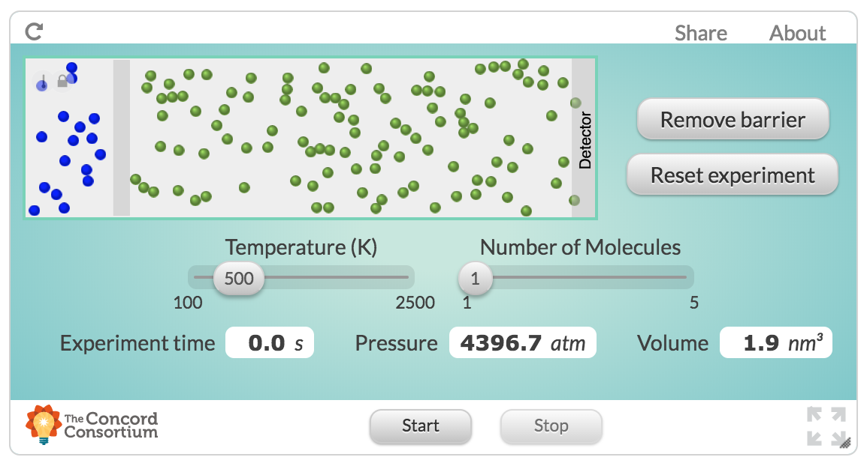
Supporting students to do data science
Introduction | ESM | Text | Digital Traces | Future Work | Conclusion
Past studies were not in contexts not designed and developed to help teach students data science

Slide 55
Supporting students to do data science
Introduction | ESM | Text | Digital Traces | Future Work | Conclusion
Build on collaboration with Michigan Virtual School (Rosenberg, 2017, MVLRI RPIN) to design activities and tools to make it easier for students to use data in online science classes
Focus on data wrangling (accessing, organizing, and transforming data) to expand opportunities to work with data
Partner with faculty across departments at University of Tennessee, Knoxville to support and document work with data at post-secondary level
Strong potential for funding (NSF DRK-12)

Slide 56
Supporting teachers to work with data
Introduction | ESM | Text | Digital Traces | Future Work | Conclusion
Teachers find the shift toward more open-ended work with data to be challenging and working with teachers to study and show how these activities are possible is important

Slide 57
Supporting teachers to work with data
Introduction | ESM | Text | Digital Traces | Future Work | Conclusion
Engage pre-service and in-service teachers in coursework and opportunities to ”hands-on” work with data
Explore how work with in mathematics and engineering classes allows learners to more deeply engage in science as part of a positive “feedback loop”
Potential for collaborative work across the Theory and Practice of Teacher Education department and impact on teacher preparation coursework
Opportunities to involve teachers in design and development of technological tools (i.e., support TPACK)

Slide 58
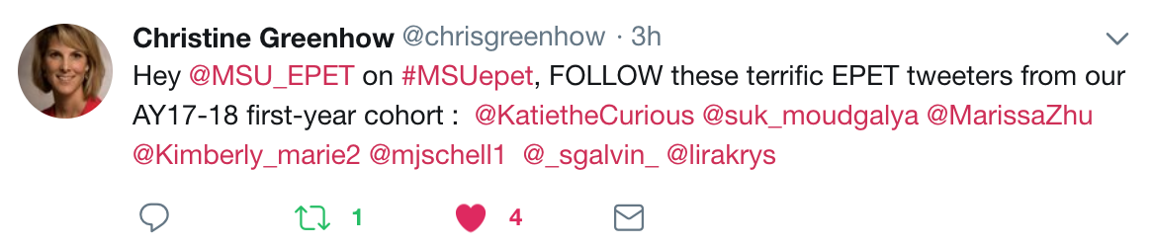
Leveraging the network effect
Introduction | ESM | Text | Digital Traces | Future Work | Conclusion
Scale innovations in STEM teaching and learning through Digital Traces

Slide 59
Leveraging the network effect
Introduction | ESM | Text | Digital Traces | Future Work | Conclusion
Understand how involvement in formal and informal digital communities supports changes in practice
Understand how access to specific resources or people at specific times impacts involvement in a community
Opportunities for expanding impact and carrying out research through foundations (Gates Foundation and programs focused on addressing equity through Digital Traces of researchers, administrators, and practitioners)

Slide 60

Introduction | ESM | Text | Digital Traces | Future Work | Conclusion
Thank you to participating teachers and students and to collaborators!
Joshua Rosenberg jrosen@msu.edu
http://jmichaelrosenberg.com
@jrosenberg6432
Michigan State University
Notes:
Demonstrate how data can be used to empower teachers and students.

Slide 61
References
Introduction | ESM | Text | Digital Traces | Future Work | Conclusion
Cobb et al., 2003
Turner & Noley, 2015
Mishra, Koehler, & Greenhow, 2016
NGSS Lead States, 2015
National Research Council, 2012
Severance et al., 2012
Wilkerson-Jerde & Wilensky, 2015
Rosenberg & Koehler, 2015
Rosenberg et al., 2016
Koehler et al., 2016
Schmidt, Rosenberg, & Beymer, 2018
Beymer, Rosenberg, & Schmidt, in press
Akcaoglu, Rosenberg, Ranellucci, & Schwarz, 2018
Notes:
Demonstrate how data can be used to empower teachers and students.

